Slide 1
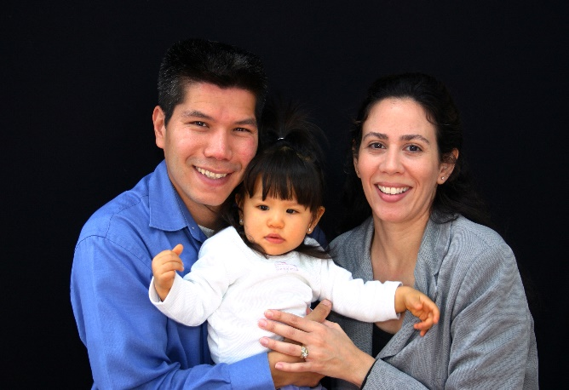
Introduction to Cultural Responsiveness
A Training Tool
A Service of the Children’s Bureau, a member of the T/TA Network

Slide 2
Overview

Slide 3
Cultural Responsiveness Overview
Why cultural responsiveness?
What is it, and why is it important?
What is the framework for cultural responsiveness?
What are the elements?
What does it mean to be culturally responsive?
How can cultural responsiveness be assessed?

Slide 4
Why Cultural Responsiveness?

Slide 5
Evolving to Cultural Responsiveness
The 2010 Census showed the U.S. to be more ethnically and culturally diverse than at any other time in history creating unique challenges for state programs and services.
To more effectively support state CBCAP SLAs
around these challenges, program implementation and service delivery needs to build on cultural competency ideals by incorporating cultural humility principles as critical aspects of effective practice.
Effective practice and service delivery in today’s communities requires a shift to a responsiveness framework and approach which goes beyond gaining knowledge and developing an understanding of diverse
communities and cultures.

Slide 6
Cultural Responsiveness

Slide 7
What is Cultural Responsiveness?
Cultural responsiveness is when programs and services evolve to appropriately engage and partner with families and communities in the design, delivery, and evaluation of effective and appropriate services.
These services are then framed by an understanding of culture, cultural competency, and cultural humility creating a culturally
responsive foundation for families and communities
to be engaged and supported utilizing the
strengths of their diversity and cultural
dynamics.
Source: Child Welfare league of America (2014)

Slide 8
Why Cultural Responsiveness?
It calls for continuously gaining first hand knowledge and understanding of the varied strengths and needs of diverse families and communities.
It enables workers to learn from families and communities as well as their coworkers and others in the workplace.
It requires that workers and systems reserve judgment of families and communities.
It facilitates learning to bridge cultural gaps between differing perspectives.

Slide 9
A Framework for Cultural Responsiveness

Slide 10
The Elements of Cultural Responsiveness
Cultural Competency
Cultural Humility
Cultural Responsiveness
The Meaning of Culture
Importance of Cultural Competency
Importance of Cultural Humility

Slide 11
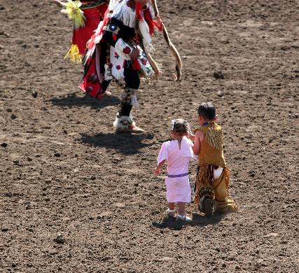
Culture
Is a constantly changing, learning pattern of customs, beliefs, values, and behaviors, which are socially acquired and transmitted through symbols, rituals, and events and which convey widely shared meanings among its members. Culture includes elements such as gender, age, sexual orientation, geographic location, ethnicity, personality, ability status, marital status and job position.
Source: Child Welfare League of America (2013)

Slide 12
Why Does Understanding Culture Matter?
It matters because:
It is a filter through which people process their experiences and events of their lives.
It influences people’s values, actions, and expectations of themselves.
It impacts people’s perceptions and expectations of others.

Slide 13
Importance of Culture
It informs our understanding of when support is needed.
It influences how and from whom we seek support.
It influences how we attempt to provide supports and services.

Slide 14
Cultural Competence
Is the ability of individuals and systems to respectfully and effectively interact with people of all cultures, classes, races, ethnic backgrounds, sexual orientations, ability statuses, and faiths or religions, in a manner that recognizes, affirms, and values the worth of individuals, families, tribes and communities, while protecting and preserving the dignity of each.
Source: Child Welfare League of America (2013)

Slide 15
Why does cultural competence matter?
It helps us:
Recognize the broad dimensions of culture.
Respect families and communities as the primary source for defining strengths, needs and priorities.
Increase sensitivity to alienating behaviors.
Change decision-making processes to include families and the community.

Slide 16
Why does cultural competence matter? Continued
Commit to structural and policy changes that support cultural diversity.
Make policies and practices fluid to accommodate necessary adjustments.
It helps us:
Source: Focal Regional Research Institute for Human Services, Portland State University (2003)

Slide 17
Cultural Humility
Promotes self-awareness, the acknowledgement that the experiences of others are different than ours and requires that we be open and respectful of their perspectives, and that out of acceptance we develop understanding and the recognition that others have a positive worth – they matter.
Source: Ortega, R. M. & Coulborn-Faller, K. (2011)

Slide 18
EXERCISE

Slide 19
UM SSW R&R Project
http://www.ssw.umich.edu/r&r

Slide 20
Exercise Instructions
1) List as many identities as you can think of and rank them in order of importance with “1” being your most important identity.
2) Now review your list of identities and consider the following question – How would you react to someone trying to remove one of your “1” identities (e.g. a part of you).
http://www.ssw.umich.edu/r&r/

Slide 21
Why Does Cultural Humility Matter?
It helps us:
Appreciate who an individual is from their cultural perspective and how this shapes the lens through which they see others and the world.
Acknowledge that no one can know all there is to know about individuals or the world.
Know that the experiences of others – coworkers and those you/we are helping, requires that you/we be open and understanding of their point of view.

Slide 22
Why Does Cultural Humility Matter? continued
It helps us:
Draw on the cultural experiences and knowledge of families and individuals we work with.
Recognize that the cultural experiences of others can exceed our capacity to fully understand all there is to know about a culture.
Understand that an individual’s social experience impacts how they see the world and how they express their culture.
Develop an understanding of, and respect for, an individual’s or family’s unique culture and ethnic heritage.
Source: Ortega, R. M. & Coulborn-Faller, K. (2011), University of Michigan

Slide 23
Culturally Responsive
Values and Principles

Slide 24
For the Individual
Assess
A willingness to accurately assess yourself and your limitations.
Embrace
Embrace the complexity of diversity.
Be Open
Be open to new ideas, information, and advice that may conflict with your own.
Acknowledge
Acknowledge gaps in your cultural knowledge and understanding

Slide 25
For the Organization
Support
Build organizational support that demonstrates the importance of cultural responsiveness.
Integrate
Sanction, and if necessary mandate the integration of cultural knowledge and understanding in policies, infrastructure, and programs.
Embrace
Embrace the principles of equal access and non-discriminatory practices.

Slide 26
For Programs and Services
Collaborate
Collaborate with individuals and families to accurately identify and understand needs, strengths, and cultural based behaviors.
Design
Design and implement services that integrate the knowledge and unique cultural experiences of individuals, families, organizations, and communities served.
Drive
Drive programs using first-hand knowledge and understanding of the varied needs of diverse families and communities—not stereotypes or general assumptions.
Sources: Georgetown University Center for Child and Human Development (2013), Ortega, R.M. & Coulborn-Faller, K. (2011)

Slide 27
Making Cultural Responsiveness Work
Value Diversity
Continually
Self-Assess
Develop Awareness of and Acknowledge Cultural Dynamics
Integrate Cultural Knowledge and Experiences
Adapt Service Delivery

Slide 28
Value Diversity

Slide 29
Value Diversity
Create an environment in which people feel safe to express culturally based values, perceptions, and experiences.
Host social events at which music, food, & entertainment reflect cultures represented.
Hire staff and leaders who understand the community’s cultural diversity.
Partner with local cultural organizations and groups.

Slide 30
Continually
Self-assess

Slide 31
Continually Self-Assess
Continually and transparently explore values, beliefs, and attitudes about your culture and others.
Non-defensively engage the entire organization, families, and the larger community in regular self-assessments.
Periodically review whether recruiting and hiring practices and policies ensure diverse staffing and representative leadership.

Slide 32
Continually Self-Assess continued
Frequently review participation and satisfaction rates of families served from various cultures.
Regularly review program practices, activities, and services.
Regularly review methods of engagement and communication to ensure cultural appropriateness.
Assess the program environment and décor.

Slide 33
Continually Self-Assess continued
Be open to revising the organization’s mission and objectives.
Evaluate whether current staff understand the importance of cultural responsiveness.
Consider using resources like the “Peer Review in CBCAP: A Source Document for Assessment and Best Practice”, found at: http://friendsnrc.org/peer-review

Slide 34
Develop Awareness of and Acknowledge Cross-Cultural Dynamics

Slide 35
Develop Awareness OF and Acknowledge Cross-Cultural Dynamics
Understand how historical and political differences between cultural groups impact relationships and opinions.
Build capacity to communicate with non-English–speaking families.
Develop correspondence and other engagement materials that are linguistically appropriate and specifically for the literacy levels of families being served.

Slide 36
Develop Awareness of and acknowledge Cross-Cultural dynamics continued
Be non-judgmental, respectful and responsive to non-traditional families (gay and lesbian parents, kinship families, single fathers, etc.).
Understand how varied religions and faiths influence values and behavior (sacred or holy days, etc.).

Slide 37
Integrate Cultural Knowledge and Experiences

Slide 38
Integrate Cultural knowledge and experiences
Create and / or adopt principles of practice that incorporate the elements of cultural responsiveness.
Develop a permanent advisory group that focuses on cultural responsiveness.
Maintain a current library of resources, publications, meeting notes, and materials from trainings that reference culture responsiveness .
Create a budget line-item for culturally based exchanges and training.

Slide 39
Adapt Service Delivery

Slide 40
Adapt Service Delivery
Communicate with parents in the manner they prefer (orally, in native language, interpreter, etc.).
Provide staffing that has a working understanding of the culture (s) served.
Staff should be linguistically and ethnically representative whenever possible.
Develop community-based teams to assist with program development and implementation.

Slide 41
Adapt Service Delivery continued
Make referrals to providers that have demonstrated the value of cultural responsiveness.
Leverage cultural strengths (faith, respect for elders, broad sense of family, etc.).
Tailor outreach and engagement methods to the cultures represented in the community.

Slide 42
Getting Started: A Basic Foundation

Slide 43
Basic Foundation
Identify cultural diversity within the community
Does the organization and the staff have an understanding of the cultural and ethnic composition of their service population (review local/state U.S. Census data)?

Slide 44
Basic Foundation continued
2. Conduct a comprehensive assessment of yourself and your organization:
Is cultural diversity discussed and celebrated?
Do staff and the organization understand and respect the cultures represented?
Do programs address the unique needs and concerns of the cultures represented?
Is cultural responsiveness reflected in policies, practices, employee evaluations, and procedures?

Slide 45
Basic Foundation continued
3. Engage in dialogue with cultural and ethnic communities with which you work:
Convene informal gatherings with personnel to explore beliefs, values, and attitudes related to cultural responsiveness.
Build and use a network of community experts who have knowledge of the cultural and ethnic groups served.
Network with parents and family organizations.

Slide 46
Basic Foundation Continued
4.Identify and understand the specific needs and behaviors of individuals and families first hand.
5. Draw on the cultural expertise of the individuals and families you work with and recognize their experiences likely exceed your own.
6. Identify best practices by learning from other organizations and individuals.

Slide 47
Basic Foundation Continued
7. Design and implement services that are based upon families’ and the communities’ culturally based choices and experiences.
8. Culturally adapt/tailor existing evidence based programs and practices to ensure they are responsive to the families and communities served.
9. Integrate policies, practices, and structures with culturally responsive values and principles.
10. Frequently reassess and make needed adjustments.
11. Keep learning and asking questions (see Resources handout).

Slide 48
Additional Resources and Information
For resources and information regarding the concepts or ideas presented in this workshop, go to:
http://friendsnrc.org

